Slide 1


Cyberbullying Detection
By:
John Hani
Mohamed Nashaat
Mostafa Ahmed
Zeyad Emad (Team Leader)
Under supervision of :
Dr. Eslam Amer
Eng. Menna Gamil

Slide 2




You’re
Trash
Personal pronoun used when directly addressing people
An offensive word when combined with personal pronouns creates a cyberbullying sample

Slide 3

Why
Don’t
you
go
kys
Kys is a slang word which stand for kill yourself also considered as a cyberbullying sample
http://www.noswearing.com/dictionary

Slide 4
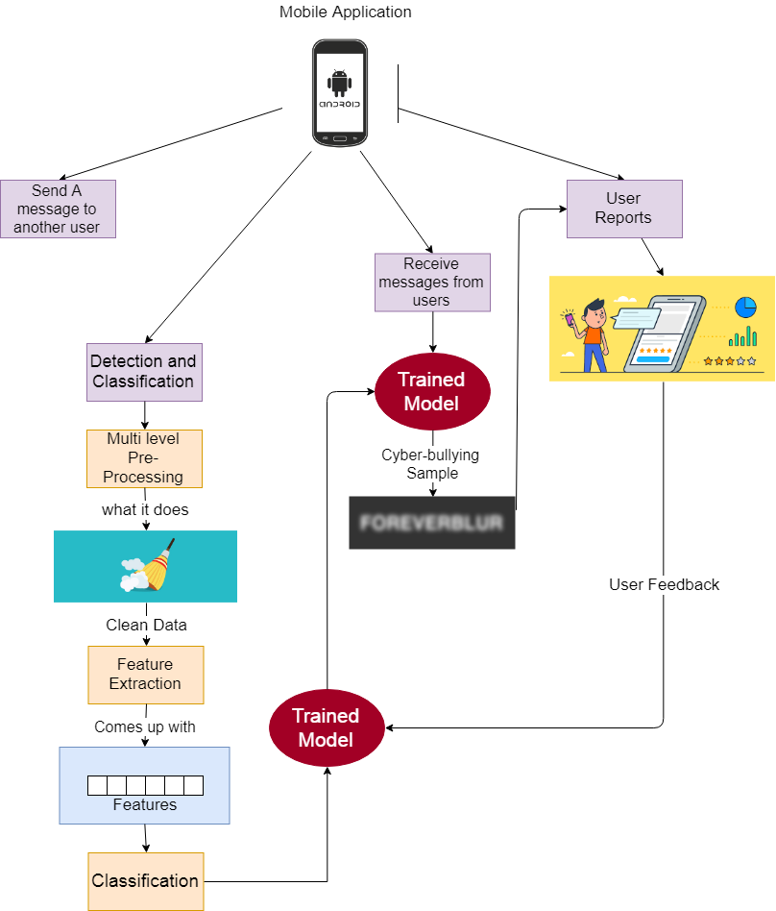

Slide 5
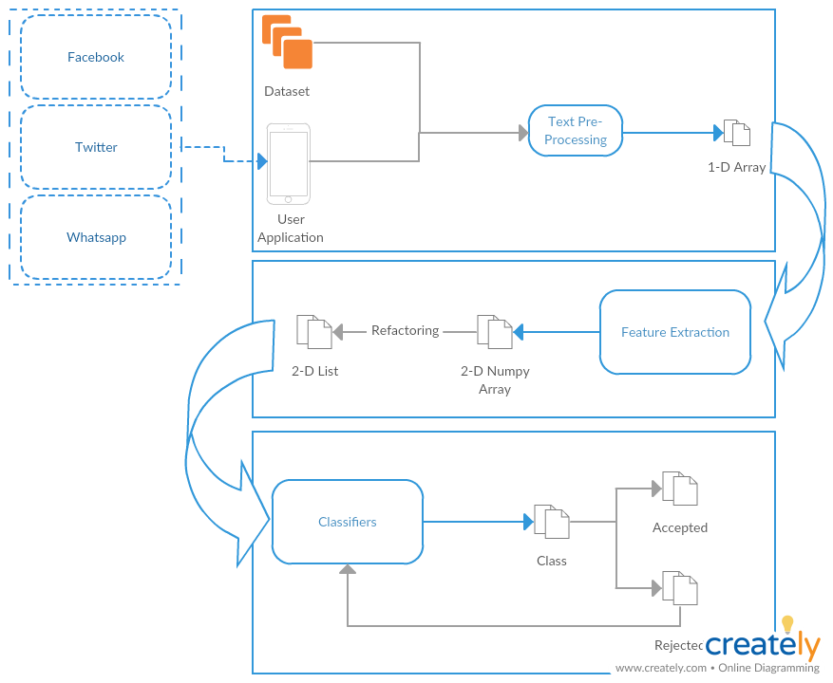
System Overview
Self Learning

Slide 6
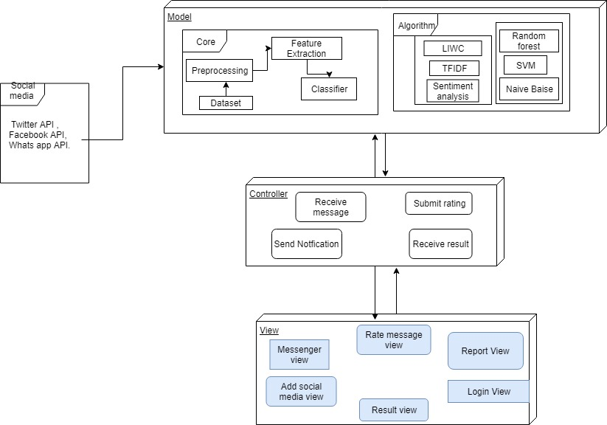
System Architecture
Feature
Extraction
Classifiers

Slide 7
Most Important Algorithm
Sentiment Analysis
What is Sentiment Analysis ?
Why we chose it ?
How it works ?

Slide 8
Functional Requirement
User | Login with social media Rating
Messages | Send messages & Receive messages Encrypt & Decrypt
Processing | Preprocessing Feature extraction Classification
System | Notify Result Upgrade Classifier

Slide 9



Non Functional Requirements
Security
Maintainability
Portability
Have Encryption and Decryption
Self Learning
Both Desktop and Android

Slide 10
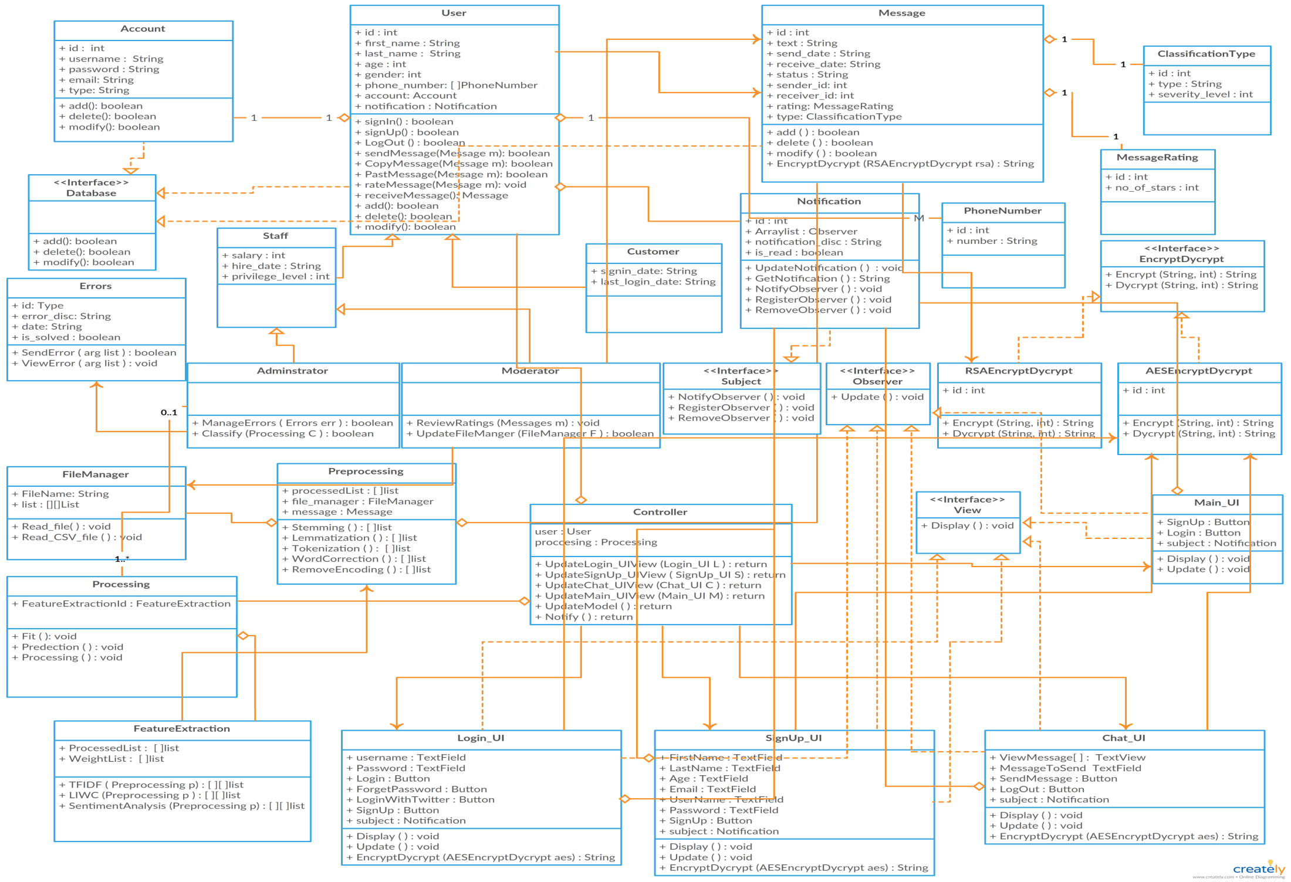
Class Diagram

Slide 11
Demo

Slide 12
Any Questions ?

Slide 13
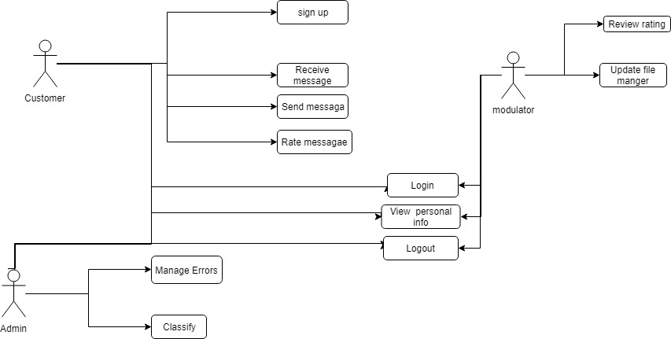
USE Case

Slide 14
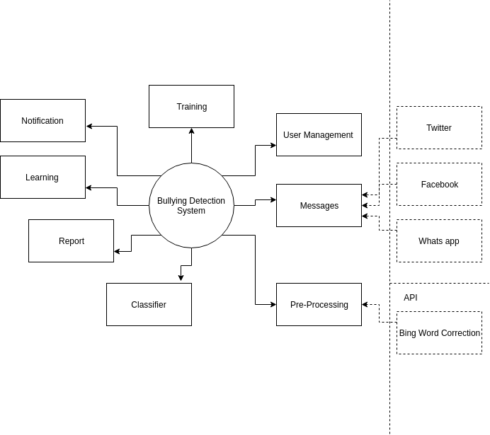
Context Diagram

Slide 15
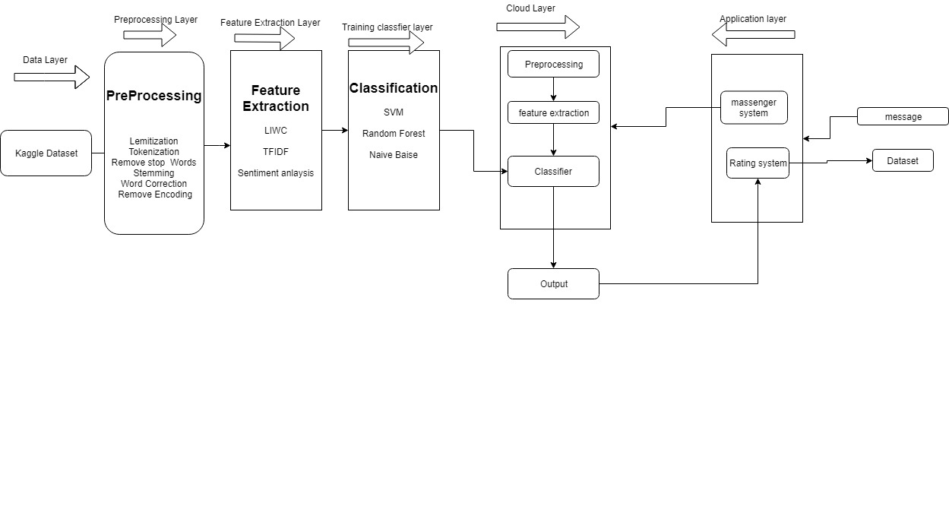
Block diagram

Slide 16
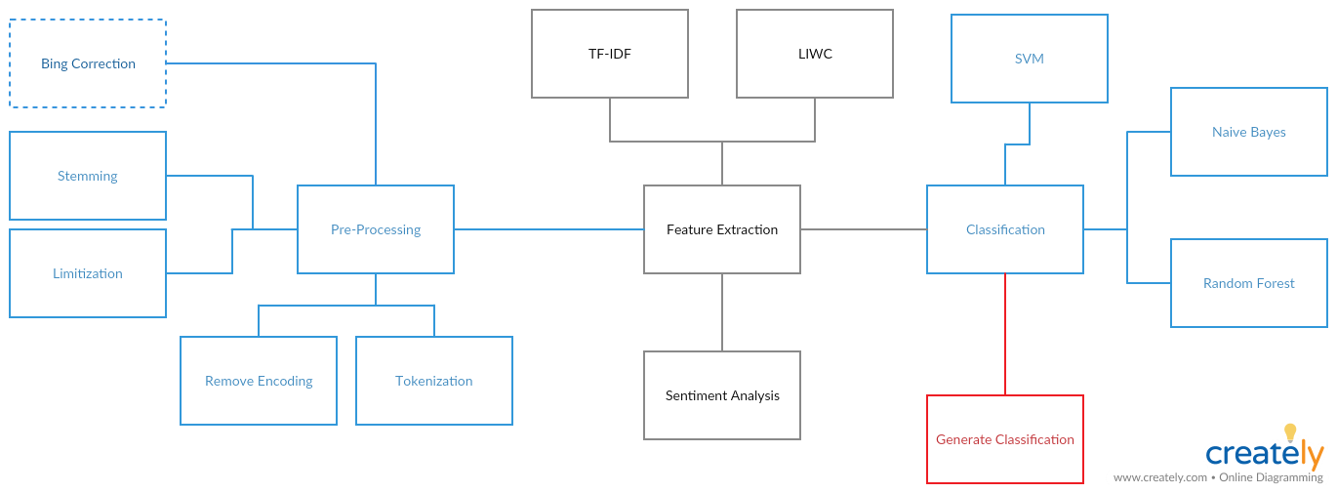
Block diagram

Slide 17
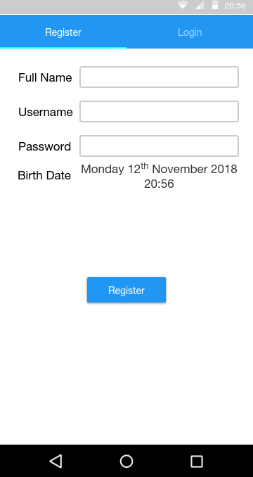
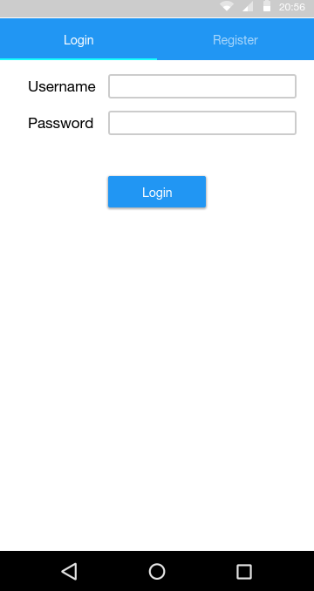
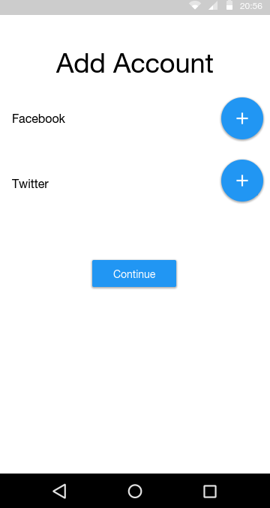
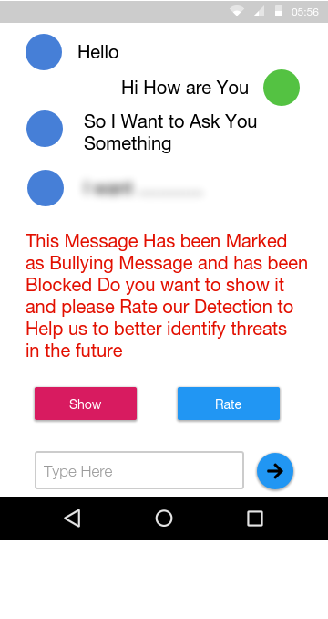
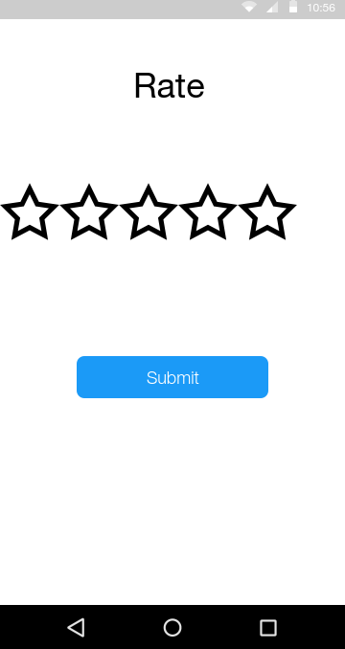
GUI

